Slide 1
Module 6: Introducing Server Administration
Siebel Core Developer and Technology School
Notes:
Time: Lecture: 30 – 40 minutes; labs: 25 – 30 minutes
Intent: To introduce Server Administration and explain how it is used to administer and configure the Siebel enterprise. In the previous module, students installed the Siebel Gateway, Siebel Server, Database Server, and Siebel Web Engine (SWSE) to run the Web client. Now they will learn how to use Server Administration screens to administer and configure their Siebel enterprise.
Flow: Server Administration screens, the role of the Server Manager, two ways to administer the enterprise, server components, component groups, component definitions, server tasks, setting parameters, component types, component states, starting batch and background components, and viewing task information.
Key Terms:
Server Administration
Server Manager
Server component
Component group
Component definition
Run Mode
Batch
Interactive
Background
Jobs
Task
Sessions
Parameters
Named subsystems
Delete Parameter Override
Please note: Faculty-specific notes are italicized.

Slide 2

Module Objectives
After completing this module you will be able to:
  Describe Server Administration concepts and tasks
  Navigate Server Administration screens and views
Why you need to know:
  A fundamental understanding of Server Administration concepts is required before performing these activities
Notes:
Each objective and “why you need to know” should be stated aloud.

Slide 3
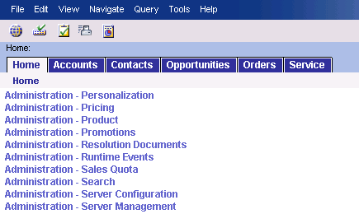
Server Administration
A set of screens and a command line interface that act as an interface to the Server Manager component allowing you to configure and manage:
  The Siebel Enterprise Server
  Individual Siebel Servers
  Siebel Server components, component groups, and parameters
Site Map
Notes:
Using Server Administration screens, users can administer Siebel Servers within an Enterprise Server and monitor the status of the various server components and component tasks.
New with 7.7 is the separation of screens associated with server configuration (Administration – Server Configuration) and server management (Administration – Server Management).

Slide 4

Server Administration Continued
There are two ways to perform server administration tasks:
Both methods start a session on a Siebel Server and a task is started on all Siebel Servers within the specified Enterprise
From the Siebel application interface
From the command line
Notes:
When Server Manager is invoked, it connects to the Siebel Gateway and gathers all connectivity information for each Siebel Server within the Siebel Enterprise. The Server Manager then starts a task on each Siebel Server within the Enterprise and displays servers for each enterprise supported by the Siebel Gateway.
Users can perform server administration two ways:
The user interface (UI), through the Server Administration views of the Siebel client. Use the UI for most administrative duties because the UI includes greater functionality, for example, searching and sorting of fields. It also provides a more intuitive view of Siebel Server operations.
The command-line interface can be used to invoke batch components, background components, and script files with administration commands that need to be run on a regular basis.
Students will have practice using both techniques in the upcoming labs.

Slide 5
Server Components
A component is a type of program that runs on the Siebel Server
The standard Siebel application comes with many server components, for example:
  Object Manager (OM)
    Creates and processes data at multiple levels
  Server Manager
    Administers Siebel Servers within the Enterprise
  Assignment Manager
    Assigns work based on business rules
Notes:
The various programs that operate on the Siebel Server are known as server components. A component represents only a specific type of program; a component is executed or operated as a task, or instantiation of a component, on a specific Siebel Server. (We talk more about instances in the following slides.) There are many server components delivered in the standard Siebel application. The server components listed in the slide are some of the ones covered in this course.

Slide 6

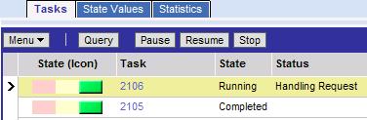
Tasks
When a component executes, it is called a task
  An instantiation of a component and runs in computer memory
  Several instances of the same component may run simultaneously
    Example: Multiple Batch Assignment tasks can run concurrently on the Siebel Server
  A task updates its state during execution
Notes:
Students practice submitting server tasks in the labs throughout the course.
The Task Status icon is a new UI feature with 7.7. The task state can be seen in the UI using the Task Status icon. The task state can also be determined from the command line:
<Srvrmgr> list state values for task <task number>

Slide 7
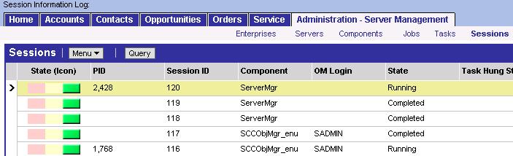
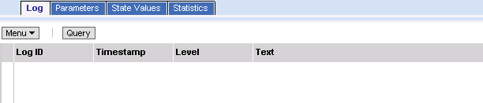
Sessions
Provides information on a particular session including log, parameters, state values, and statistics
View tabs provide additional information on the selected session
Notes:
A Sessions View has been added in this current release. This allows administrators to monitor users logged in and their current activity.
Some of the Session information displayed on the slide includes session state, the Component, in this case Server Manager, and then any applicable Object Manager Login.
Demo this feature by navigating to Administration – Server Management > Sessions, or click Sessions from the Administration – Server Management link bar.

Slide 8
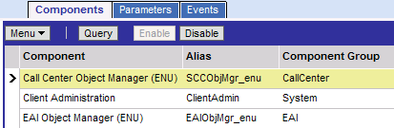
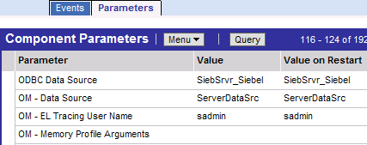
Parameters
Settings for servers, components, and tasks
  At startup, a task reads parameters and executes according to their values
Component
parameters for Call Center OM
Notes:
Students practice setting task parameters in the labs throughout the course.

Slide 9
Setting Parameters
Parameters are set at any of these levels
  Parameters set at the enterprise level are inherited for the entire enterprise
  Parameters set at the task level override the same parameters set at a higher level
Enterprise
Highest level
Server
Component Definition
Named Subsystem
Server Component
Task
Lowest level
Notes:
Component definition is higher than server component in the parameter hierarchy. For example, a server component-level parameter overrides the value in the component definition.
New for 7.7 is the feature Delete Parameter Override, and is discussed in the next slide.

Slide 10
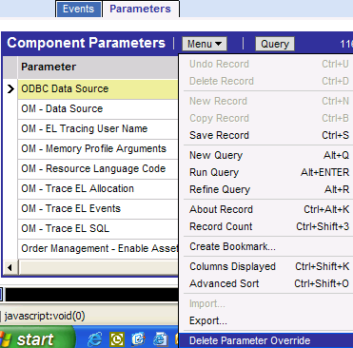
Delete Parameter Override
User can remove a parameter setting
  Value then comes from the next higher layer
From any Parameter list view, click the applet-level Menu button
Select Delete Parameter Override
Notes:
This is a new feature for 7.7. If parameter settings are removed, the value comes from the next higher layer.
Here is a scenario to illustrate with the class. Suppose you had previously overwritten the inherited parameter by changing the parameter value on a lower-level task. Now you want to revert back to the inherited parameter. Simply deleting the parameter from the task results in a NULL value rather than the inherited value, so you must select Delete Parameter Override to remove the override and reinstate inheritance for the parameter.
This option is present from within any parameter list view. Open the applet-level Menu, then select Delete Parameter Override. Delete parameter override allows the associated parameter to receive its value from the next higher layer.

Slide 11
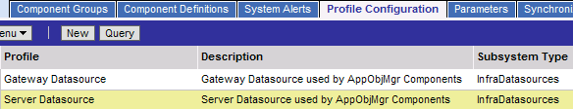
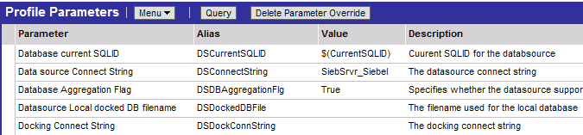
Parameters: Named Subsystem
A logical collection of related parameters referenced by many server components
ServerDataSrc is a named subsystem specifying the data source connection for the Application OM component
List of parameters for the selected named subsystem
Notes:
For example, the ServerDataSrc named subsystem (the screenshot highlights this example) which contains values to connect to the server database, is also the value of the OM – Data Source component parameter in the Call Center OM, the Siebel Sales OM, and so on.
To demo this feature, navigate to Administration – Server Configuration > Enterprises > Profile Configuration view tab.

Slide 12
Parameters: Named Subsystem Continued
Created by assigning values to some or all parameters in a subsystem
  Values are stored in the Siebel Gateway Name Server
Useful because subsystems can be defined and managed in one place but can be referred to in multiple places
Notes:
The Application Object Manager can maintain several different values for a particular parameter using named subsystems.

Slide 13
Server Component Modes
0/3
Batch
Background
Interactive
Notes:
This is a positioning slide. Do not discuss each mode here since details on each component mode are described in the following slides.

Slide 14
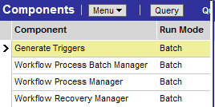
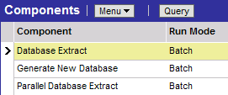
Batch Components
1/3
The task runs until completion, and then it stops
Started manually via:
  Graphical user interface
  Command-line interface
Examples:
Subset of Workflow Management component group
Subset of Remote component group
Notes:
Batch mode components end once the task has been completed. Examples of these are Enterprise Integration Manager, Database Extract, Generate New Database, and Generate Triggers.
Batch components can also be started by other components, such as workflows in Enterprise Application Integration.

Slide 15
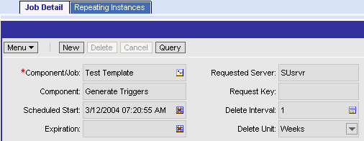
Batch Components: Jobs
1/3
Jobs are batch component requests
  Run on a regular or occasional basis
  Use the same set of parameters each time
When a job is submitted, it runs as a task
Job templates can be created rather than re-entering parameters each time
Repeating Jobs can be scheduled to run on a regular basis
Enter values to schedule a job on a regular basis
Notes:
With 7.7, Jobs replace what was known in earlier versions as component requests. Job Templates are new with 7.7. Procedural steps for creating and defining job templates are covered in the next module.
To demo this screen, follow these steps:
Navigate to Administration – Server Management > Jobs, or click Jobs from the Administration – Server Management link bar.
This takes you to the Batch Jobs list applet, where Jobs can be created.
Only batch-mode component tasks are started by running a job.

Slide 16

Background Components
2/3
The task runs continuously until the component is shut down
  Runs repetitively, defined by a sleep time
Started:
  Manually via command line
  Automatically upon server startup
Example:
Subset of Remote component group
Notes:
Components with the parameter Default Tasks > 0 start automatically when the Siebel Server is started. Examples of these components are Transaction Processor, Transaction Router, and Transaction Merger. They can also be started from Server Manager via the command line.
Background mode components execute tasks to perform background operations for the Siebel Server. Once a background mode component task starts, it runs until you explicitly stop the task, or until the Siebel Server itself is shut down.

Slide 17

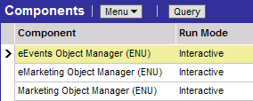
Interactive Components
3/3
The task runs in response to client requests
  No need to manually start
The task stops when the client disconnects
Examples:
Subset of Siebel Call Center component group
Marketing Object Manager component group
Notes:
Interactive mode components start tasks automatically in response to client requests. Interactive mode component tasks execute for as long as the client maintains the session, and end when the client disconnects. Examples of interactive mode components include Synchronization Manager and Object Manager (used generically to refer to all application object managers).

Slide 18
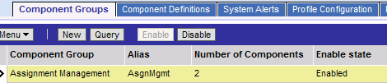

Component Groups
Logical groupings of Siebel Server components
  Example: The Assignment Management component group consists of two server components
Component group must be enabled…
…to use any of the server components
Notes:
Component groups are logical groupings of server components that are parts of a process.

Slide 19
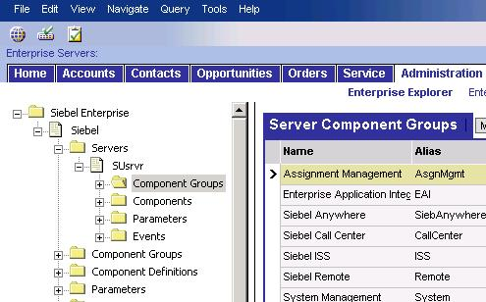
Component Groups Continued
Are assigned to one or more Siebel Servers on which they execute tasks
  Components are defined at the Siebel Enterprise level in component groups
Component Groups specific to SUsrvr
SUsrvr Component Groups
Enterprise Component Groups
Notes:
Component groups can be enabled during installation, or enabled afterwards via the Siebel UI. Students learn how to enable components via the UI in the lab. Siebel Applications provide a number of predefined component groups.
New with 7.7 is the Enterprise Explorer configuration tree. To demo this screen, navigate to Administration – Server Configuration. From here, either select Enterprise Explorer from the listed options, or click Enterprise Explorer on the link bar.
The Enterprise Explorer configuration tree offers a simplified way to select components and set the associated values referenced in the shared screen list applet. As you can see on this slide, each folder expands to display the contents making up that folder.

Slide 20
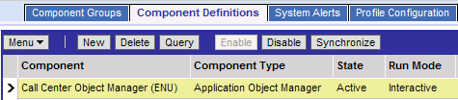
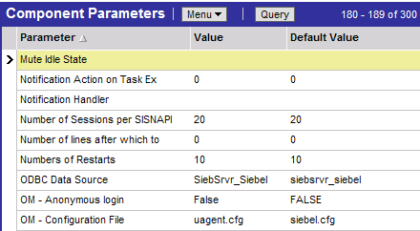
Component Definitions
Use to tailor existing components or create custom components, for example:
  Modify component definition so that same parameter values are in effect each time the task executes
Parameters for the Call Center Object Manager component
Notes:
Parameter values in a component definition are used to initialize the component on a specific server. An advantage of using component definitions is that it can save you time at run time. By having your parameter values already defined, there is no need to change them before you submit the request.
Here is an example: You need to import new accounts from a legacy system every Monday. Therefore, you have created the new_accounts.ifb file that will always be used for this EIM task. You can create a special EIM component definition called Import Weekly Accounts that will only import these new accounts, because it will always use the new_account.ifb file.
To demo this feature, navigate to Administration – Server Configuration > Enterprises > Component Definitions view tab.

Slide 21
Summary
This module showed you how to:
  Describe Server Administration concepts and tasks
  Navigate Server Administration screens and views
Notes:
Review Question: What are the two ways to perform Server Administration?
Answer: Perform Server Administration using the UI or the command line interface.
Review Question: Why must component groups be enabled?
Answer: To execute components on the Siebel Server, the component group to which they belong must be enabled.

Slide 22
Lab
In the lab you will:
  Explore the Enterprise using the Enterprise Explorer.
Notes:
See lab instructions for details.

